Slide 1
Understanding Changes to the TCPA
And how Blackboard is making compliance easier
June 2016
Notes:
Welcome to our Webinar “Understanding Changes to the TCPA”
Thank you so much for joining us. I’m really looking forward to sharing some important updates about this updated set of regulations, and how Blackboard can help. I know there has been a lot of chatter throughout the K-12 world about this, and we hope to provide some information and clarification that will help.

Slide 2
Agenda
What is the TCPA?
A short overview of the Telephone Consumer Protection Act.
How does TCPA impact schools?
What you need to do in order to stay compliant with new regulations.
How can Blackboard help?
A review of changes being implemented to facilitate TCPA compliance.
Optimized Communication: The Big Picture
Insights for how to provide compliant, more engaging communication across your district.
Open Q&A
You’ve got questions. We’ve got answers.
Notes:
Let’s take a quick look at our agenda for today, and some of the topics that we plan to cover:

Slide 3
Today’s presentation is designed to provide you with information about the new TCPA regulations, highlight features available to Blackboard, Inc. clients designed to aid in TCPA compliant messaging, and provide best practice recommendations for effective messaging.
The information presented in this webinar represents the informed opinion of Blackboard, Inc., and should not be considered legal counsel. Before modifying or developing your district policy you should consult with your district’s legal counsel.
Notes:
Before we start, I want to make sure to set the right expectations.
Our presentation today is really designed to provide you with a better understanding of the TCPA regulations so that you can communicate confidently; to share some of the new features offered by Blackboard to help you in your compliance efforts; and to share some best practices to help you reach your community more effectively.
I am not a lawyer, however, so the information we share today represents our best, and most informed opinion, but won’t be a substitute for the guidance of your district’s legal counsel. We recommend that before you make any policy changes you consult with your legal counsel.
So with that out of the way let’s go ahead and get started

Slide 4
What is the TCPA?
Telephone Consumer Protection Act (“TCPA”), enacted in 1991.
Designed to protect consumers from fraud and receiving unwanted telemarketing messages in the form of automatic voice calls or texts.
While intended to prevent marketing messages; also regulates the use of automatic telephone dialing equipment or a pre-recorded call or text to any cell phone to provide informational content absent the recipient’s prior express consent
Violations of the TCPA can result in fines.
Notes:
So what exactly is the TCPA?
-enacted in 1991
-intended to prevent telephone fraud and unwanted marketing
-regulates autodialers/robocallers
-can result in per-call fines. This can sound scary, but before you panic – keep listening.

Slide 5
New FCC Ruling
Details of the new ruling can be found here: https://www.fcc.gov/document/tcpa-omnibus-declaratory-ruling-and-order
Here’s what you need to know:
Call only people who have given you permission
  As a non-profit, someone giving you their number may may constitute permission
Call the right person
  Every phone number has an ‘owner’. You may be calling a number with a new owner
Emergency messages are exempted under the TCPA
  “Emergency” is defined as a ”message necessary for the health and safety of the recipients”
Notes:
In July of 2015 the FCC – who manages the TCPA – made some changes to tighten up regulation.
You can see the full details of the ruling by following the link on this page, but here’s the important stuff you need to know:
-New regulations are opt-in based, as opposed to the previous opt-out model
-Schools may be able to take advantage of some special rules for non-profits
-You need to make sure you’re calling the right person
-TCPA doesn’t apply to emergency messages, so when there’s a crisis PLEASE don’t hesitate to message your community.
-FCC defines an emergency as a message necessary for the health and safety of the recipients. While this specifically applies to the phone number ‘owner’ – the parent or guardian – we would say that this applies to children in their care – your students.

Slide 6
How Do Educational Institutions Use Notifications?
General information notifications
Attendance violations
Library activity and balances
Cafeteria balances
Grades, assignments, and other academic alerts
Emergency notifications
Additional Reading:
Reminder Texts Improve College Enrollment (New York Times) - bit.ly/remindertexts
Absence Alert Policy Changes for Student Safety (Baltimore Sun) - bit.ly/attendancecalls
Notes:
Obviously this regulation impacts our K-12 clients. We all know that communication has significant benefits to student success, which is why many of our schools use mass notifications for:
-General information
-Attendance calls
-Library activity and balances
-Cafeteria balances
-Grades, assignments, and other academic alerts and
-Crisis and emergency notifications
These notifications have a huge impact on your students, and you can see a few examples at the bottom of the screen here
-Reminder text messages improved college enrollment. Some parents and students simply need a reminder to do it, or some information about how to do it.
-Morning attendance calls improve student safety. If you’re not doing this (at least at your primary schools) this is something you may want to consider.

Slide 7
Impact on Educational Institutions
Educational institutions must obtain the consent of message recipients at the time of data collection.
  Should be informed about the types of messaging they will receive
Keep consent up-to-date
Keep clean data in order to mitigate the occurrence of “re-assigned*” mobile numbers.
*A “re-assigned” number is a number relinquished by one party and re-assigned to another party.
Notes:
So how does TCPA impact K-12? Here are a few of the major impacts:
It is the responsibility of the educational institution to obtain consent. Liability will be assessed to the educational institution, not to the service provider.
Educational institutions obtain the consent of message recipients at the time of data collection. In the context of informational messaging, the recipient can give verbal or written consent.
This adds additional emphasis on the value of clean data (phone numbers, cell numbers) in order to mitigate the occurrence of “re-assigned*” numbers.

Slide 8

How Can Blackboard Help?

Slide 9

Scenario 1:
Back-to-School Night
You just sent a back-to-school night announcement
Because of bad data entry you called Bob at 555-404-1234 instead of Barb at 555-404-1235
Bob – who has no children in the district – calls and requests to stop getting calls
✔
❌

Slide 10
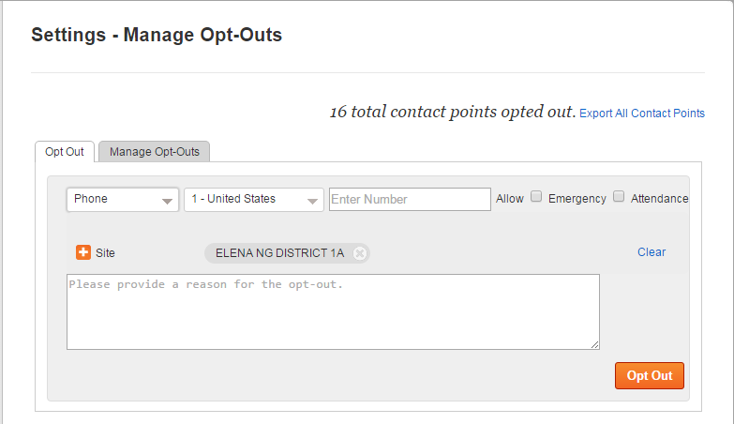
Scenario 1:
Back-to-School Night
The office staff can quickly add Bob’s phone number to the Opt Out report.
Now Bob won’t get any more calls from the district.
Opt out can be chosen for phone calls, text messages, or emails, can be applied to only informational messages or to all messages.
Notes:
Be sure to check with your district to understand what your policy is regarding emergency calls. Many states require that schools provide attendance notifications. These would be exempted by the emergency nature of attendance calls.

Slide 11

Scenario 1:
Back-to-School Night
Hi, this is Principal
Johnson. We want to invite everyone
to Back to School night, Friday September
8th at the High School gym.
To opt out of future messages call
855-502-7867.
Press * to repeat this message
All informational phone messages will include:
Touch-tone opt-out option
Opt-out footer message with opt-out hotline information
The hotline can be used for parents to opt out or in to messages
Notes:
Touch tone is good for live answered calls, and the hotline helps provide coverage for calls left on answering machines.

Slide 12
Scenario 1:
Back-to-School Night
Hi, this is Principal
Johnson. We want to invite everyone
to Back to School night, Friday September
8th at the High School gym.
To opt out of future messages call
855-502-7867.
Press * to repeat this message
Touch-tone and hotline users can automatically opt-out of informational calls, but not emergency calls.
To opt out of all messages, they’ll need to call the school to be added to the Opt-Out list.

Slide 13
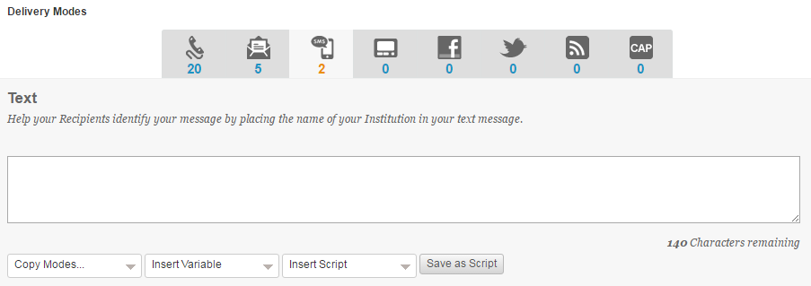
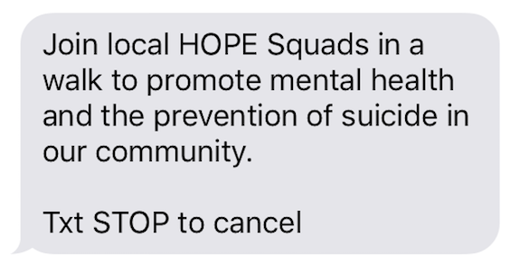
Scenario 1:
Back-to-School Night
SMS content is shortened to 140 characters
All text messages (SMS) will include opt-out instructions
Mobile subscribers can text ‘HELP’ to 23177 or 63079 for additional instructions on opting in or out
Mobile subscribers reply STOP to opt out
Notes:
Touch tone is good for live answered calls, and the hotline helps provide coverage for calls left on answering machines.

Slide 14
Scenario 2:
New phone and new phone number
Gary has consented to get all calls from the district, but he recently changed his mobile provider and has a new number.
This creates two problems:
His old phone number (555-404-5432) has been reassigned to Alice– who has not given consent to get phone calls
and
You don’t know how to reach Gary any more

Slide 15
Scenario 2:
New phone and new phone number
Blackboard automatically detects messages delivered to numbers that are likely to be bad.
This information in the bad phone number report, along with the other statuses in the call detail reports, help you to fine-tune your data and optimize your messaging
(555) 40
(533) 28

Slide 16
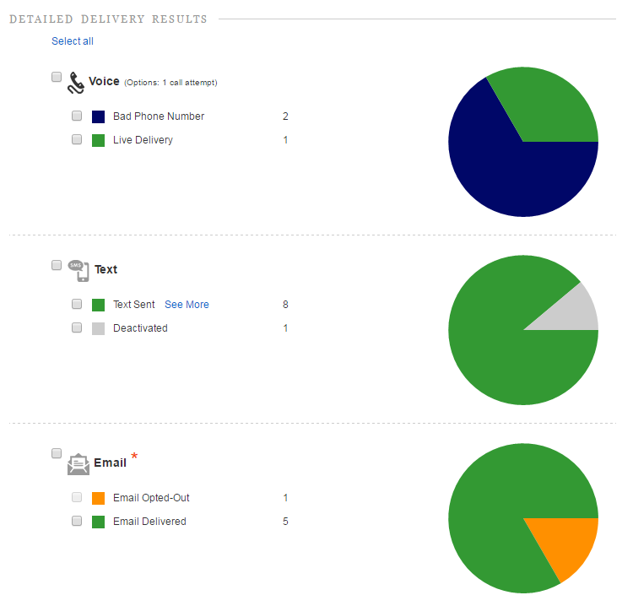
Scenario 2:
New phone and new phone number
Blackboard provides you with access to changes made in the system. Whether a phone number was flagged as bad, or deactivated, or a parent updates their contact preferences, you can view those changes here, in the Manage Opt-Outs report.
Best Practice:
Download reports regularly for review and updates. Review Detailed Delivery Results after message has completed.

Slide 17
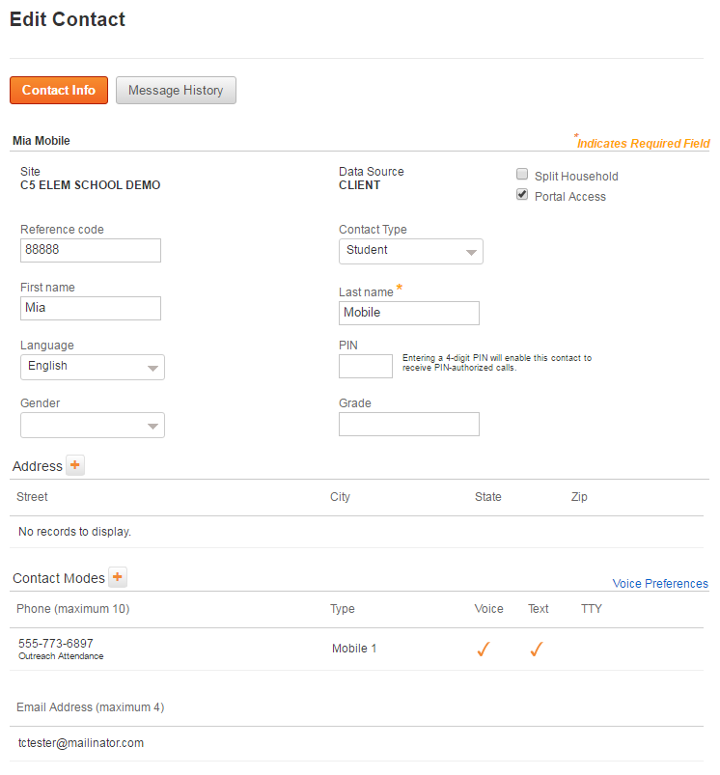
Scenario 2:
New phone and new phone number
It will be important to contact Gary to update his contact information. Your staff can view Gary’s account information to quickly see if there is another phone number or email address by which he may be contacted to update his information

Slide 18
Scenario 2:
New phone and new phone number
Blackboard will automatically identify numbers that have been deactivated and flag them for removal.
Deactivated numbers are identified in the Manage Opt-outs Report
(555) 404-5432
(340) 522-0909
(533) 286-2673
(557) 408-9237
(833) 205-1586
(714) 157-8197
(327) 336-9384
(755) 780-3562
(617) 707-8169
(384) 064-8617
(821) 398-5325
(679) 591-6797
(607) 941-1063
(266) 638-7017
(531) 397-0947
(497) 720-6579
(888) 033-4431
(555) 404-5432
(755) 780-3562
(511) 940-9307
(751) 447-9267
(617) 707-8169
Notes:
we automatically flag when numbers are ‘turned off’ and we stop making calls to that number.
We have been collecting this data for months now, so we already have a good idea of which numbers are active on day 1 when this goes live

Slide 19

Scenario 3:
School or District Emergency
No one expects a crisis to occur, but when one does you need to reach everyone – and fast!
TCPA does not impact emergency messaging, or messaging that relates to the health or safety of the consumer.
Notes:
we automatically flag when numbers are ‘turned off’ and we stop making calls to that number.
We have been collecting this data for months now, so we already have a good idea of which numbers are active on day 1 when this goes live

Slide 20
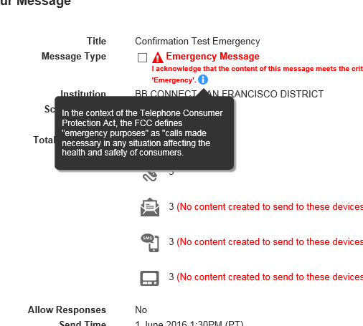
Scenario 3:
School or District Emergency
When sending an emergency message users will now be prompted to affirm the emergency nature of the message. This will help users to use the ‘Emergency’ status responsibly.

Slide 21
Blackboard Connect
Interface version 5
Availability Dates
Early August

Slide 22
Recommendations
Review your TCPA compliance policies.
  Obtain consent from message recipients at the time of collecting contact information
    Notify users at the time of data collection of your intended use of their phone number
    Include an obligation for recipients to notify you if any contact information changes
    Consider requiring recipients to indemnify you if they fail to notify you of changes. Maintain that documentation as part of your document-retention policy
Update data from SIS to communication systems often

Slide 23
Recommendations
Encourage recipients to update recipient contact information often
  Adopt an easy process for recipients to update their contact information if it changes
  Use email messages and surveys to remind users to update their information
Have a clear process for managing opt-out requests
  Immediately block the number of any recipient that opts out or notifies you that they are receiving messages in error
  Publish the opt out hotline number for informational messages

Slide 24
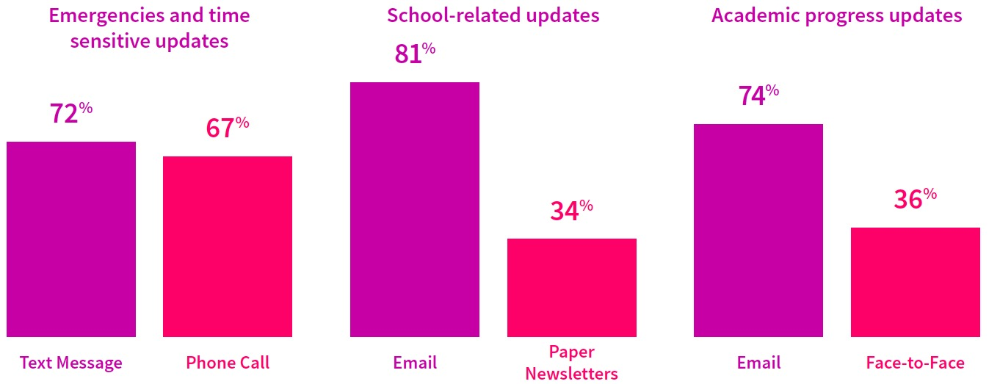

Parent Communication Preferences
General Updates
Phone Call
Academic Alerts
Text Message
  Recommendation: Maintain up-to-date e-mail lists, and consider using e-mail more frequently.
Notes:
For emergencies 72% want phone call, 67% want text messages
Email is preferred for general information and academic alerts.
Message Parents where they want to me reached.

Slide 25
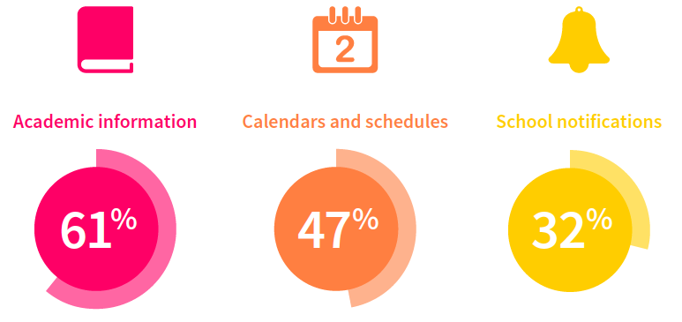
Reasons Parents Use Apps
  Recommendation: In-app notifications can alert mobile users quickly, in place of text or phone messages. Apps are opt-in by nature, and are less costly than a single TCPA fine

Slide 26
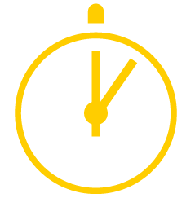
Communicate Where They Are
Parents spend an average of
1 hour 40 minutes on social
media per day
Parents are really relying more on social media to be the venue that they are seeking out their news.”
Cindy Warner
Community Ed/Public Relations
Shelby County Schools, Alabama
  Recommendation: Leverage social media outlets for general, non-specific messaging.

Slide 27
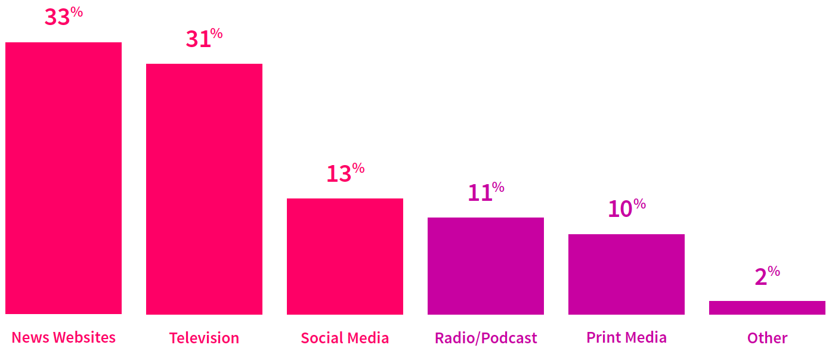
Parents Speak, We Listen
Recommendation: Use in-system website messages and news feeds for general, non-specific messaging.

Slide 28
Engage Us: Parents share their communications preferences http://bit.ly/EngageUs
Survey Says: There’s a New Culture of K12 Communication http://bit.ly/NewCommCulture
See the research:

Slide 29
Add Your Voice
See our petition at bit.ly/BbTCPAPetition
File your own comments
  http://apps.fcc.gov/ecfs/upload/display
  Blackboard’s “Proceeding Number” is 02-278.
Engage your representatives
  http://www.contactingthecongress.org/
Contact Blackboard if you need assistance

Slide 30
You have questions?
We have answers!

Slide 31
Notes:
A truly exciting future ahead.

Slide 32
New FCC Ruling
On July 10, 2015 the FCC issued a new ruling regarding the TCPA
  https://www.fcc.gov/document/tcpa-omnibus-declaratory-ruling-and-order.
Noteworthy changes:
  Recipient can revoke consent to receive messages on a mobile device by any “reasonable” means.
  The party sending the message cannot dictate the means by which such consent can be revoked.
  liability can result from messages inadvertently sent to wrong numbers, or even to “re-assigned” numbers.
    In the context of re-assigned numbers the FCC ruled that after the first call to a re-assigned number liability can result even if the calling party did not know that the number was reassigned and the recipient didn’t inform them.
  Consent/Liability exemptions:
    “emergency” messaging to cell phones, which the FCC has defined as a message necessary for the “health and safety” of the recipients.

